Slide 1
US Unemployment - Time series, Aggregation, Area Chart, Filters
File created on: 8/10/2020 6:45:55 PM

Slide 2
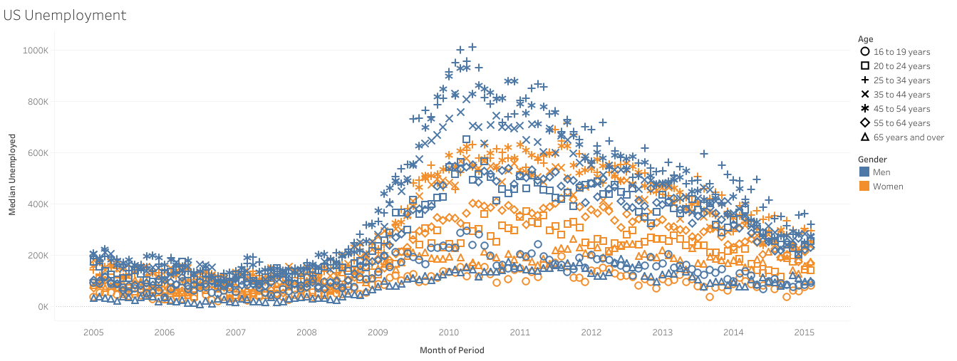

Slide 3
